Slide 1
COMP 301 Analysis of Algorithms
Growth of Functions

Slide 2
Asymptotic Notation
We use functions to characterize running times of algorithms: T(n)
We use asymptotic notation to compare running times of algorithms
Asymptotic means large input sizes (i.e. n goes to infinity)
Example: Θ(n²)
Keep in mind that there can be constant factors that we omit T(n)=an²+bn+c
The domain of functions are natural numbers: N={0,1,2…}
The domain can be extended to include real numbers
The domain can be reduced to contain a subset of natural numbers

Slide 3
Asymptotic Notation
Asymptotic notation applies to functions
Θ(n²) is obtained from T(n) = an²+bn+c
Sometimes functions can be used for other aspects of algorithms
Amount of space or RAM used
Asymptotic notation can also be used for functions unrelated to algorithms

Slide 4
Asymptotic Notation
We need to specify which running time we want to analyze and express
Worst-case, best-case, average-case, actual running time for all inputs

Slide 5

Θ-Notation
For a given function g(n), Θ(g(n)) denotes the set of functions
Worst case running time of insertion sort
Best case running time of insertion sort

Slide 6
Θ-Notation
Be careful with the notation abuse
Best to say: f(n) is a member of Θ(g(n))
The book will use f(n) = Θ(g(n)) for simplicity

Slide 7
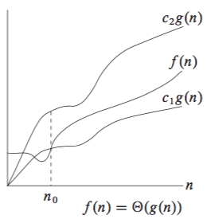
Θ-Notation
Asymptotically tight bound

Slide 8
Θ-Notation
Every member f(n) should be asymptotically nonnegative when n is sufficiently large
Consequently g(n) should also be asymptotically nonnegative

Slide 9


Example 1
Show that
Find positive constants c₁, c₂, n₀ such that
Divide both sides by n
One choice: c₁=1/14, c₂=1/2, n₀=7

Slide 10
Example 2
Show that 6n³ ≠ Θ(n²)
By contradiction suppose c₂ and n₀ exist
Divide both sides by n²
Cannot possibly hold for large n

Slide 11
Example 3
Show that f(n) = an²+bn+c is Θ(n²)
a, b, c are constants a > 0
Due to asymptotic behavior setting c₁ to lower than a and c₂ to higher than a can be sufficient

Slide 12

Θ-Notation
In general for any polynomial
a_{i} are constants and a_{d} >0
Special case: constant numbers (degree 0 polynomials)

Slide 13
O-Notation
We use O-notation when we have asymptotic upper bound only
indicates that f(n) is a member of the set O(g(n))

Slide 14
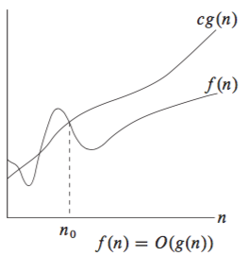
O-Notation
indicates that f(n) is a member of the set O(g(n))

Slide 15
O-Notation

Slide 16
Example 4
Show that f(n) = an²+bn+c is O(n²)
a, b, c are constants a > 0
Solution: since we showed that f(n) is Θ(n²), the result follows

Slide 17
Example 5
Show that f(n) = an+b is O(n²)
a, b are constants a > 0
Solution: take c = a+|b|, n₀ = max(1, -b/a)

Slide 18
O-Notation
When we use O-notation to express worst case running time the same bound holds for all inputs
Example: worst case running time of insertion sort: O(n²)
Implies that running time of insertion sort on all inputs: O(n²)
Not true for Θ-notation
Example: Worst case running time of insertion sort: Θ(n²)
Does not imply that running time of insertion sort on all inputs: Θ(n²)

Slide 19
O-Notation
When we use O-notation to express running time for all inputs the same bound holds for the worst-case
Example: running time of insertion sort for all inputs: O(n²)
Implies that running time of insertion sort for worst case: O(n²)

Slide 20
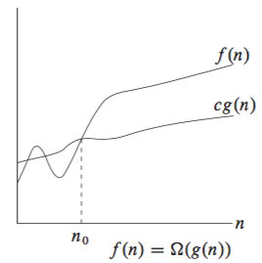
Ω-Notation
We use Ω-notation when we have asymptotic lower bound only

Slide 21
Ω-Notation
Best case running time of insertion sort: Ω(n)
Implies that the running time of insertion sort on all inputs: Ω(n)

Slide 22
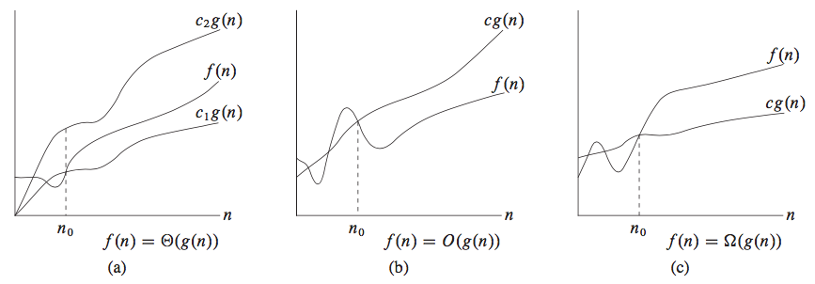
Comparison of Θ, O, Ω Notations

Slide 23

Relation Between Θ and O, Ω Notations

Slide 24
Example 6
Show that f(n) = an²+bn+c is Ω(n²)
a, b, c are constants a > 0
Solution: since we showed that f(n) is Θ(n²), the result follows

Slide 25
Example 7
Running time of insertion sort is Ω(n)
Since the best case running time is Θ(n)
Running time of insertion sort is O(n²)
Since the worst case running time is Θ(n²)
Worst case running time of insertion sort is Ω(n²)
Since the worst case running time is Θ(n²)

Slide 26
Asymptotic Notation in Equations and Inequalities
n = O(n²)
Actually means n ∈ O(n²)
2n²+3n+1 = 2n² + Θ(n)
Means 2n²+3n+1 = 2n² + f(n) and f(n) ∈ Θ(n)
Worst case running time of merge-sort
T(n) = 2T(n/2) + Θ(n)

Slide 27
Asymptotic Notation in Equations and Inequalities
2n² + Θ(n) = Θ(n²)
Means for any function f(n) ∈ Θ(n) there is some g(n) ∈ Θ(n²) such that 2n² + f(n) = g(n)
Right-hand side provides a coarser level of detail than left hand side
2n²+3n+1 = 2n² + Θ(n) = Θ(n²)
The first equation: there is f(n) ∈ Θ(n) such that 2n²+3n+1 = 2n² + f(n)
The second equation: for any g(n) ∈ Θ(n) there is h(n) ∈ Θ(n²) such that 2n² + g(n) = h(n)

Slide 28
o-Notation
The asymptotic upper bound provided by O-notation may or may not be asymptotically tight
2n² = O(n²) is asymptotically tight
2n = O(n²) is not asymptotically tight
o-notation is used to denote an upper bound that is NOT asymptotically tight

Slide 29

o-Notation

Slide 30

ω-Notation

Slide 31
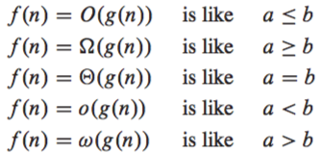
Analogy Between Comparing Functions and Real Numbers

Slide 32

Trichotomy
Holds for real numbers but NOT for asymptotic notation
Not all functions are asymptotically comparable
It may be the case that

Slide 33
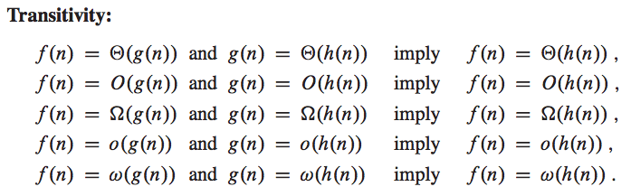
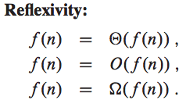

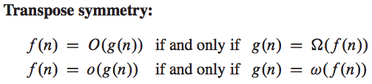
Comparing Functions

Slide 34
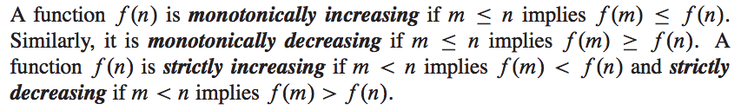
Monotonicity

Slide 35


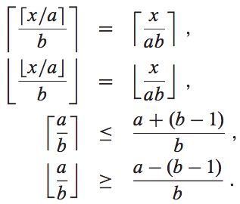


Floors and ceilings

Slide 36
Floors and ceilings
also the ceil function

Slide 37


Modular Arithmetic

Slide 38
Modular Arithmetic
If (a mod n) = (b mod n), then a ≡ b (mod n)
a is equivalent to b modulo n
a ≡ b (mod n) if and only if n is a divisor of (b-a)
a ≢ b (mod n) means a is not equivalent to b modulo n

Slide 39


Polynomials
For an asymptotically positive polynomial
For any real constant a ≥ 0 nª is monotonically increasing
For any real constant a ≤ 0 nª is monotonically decreasing

Slide 40

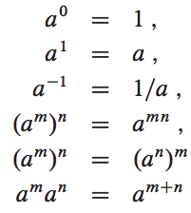
Exponentials

Slide 41


Exponentials

Slide 42






Exponentials

Slide 43
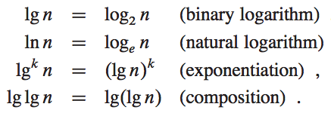
Logarithms

Slide 44
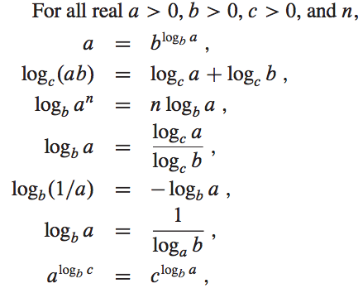
Logarithms

Slide 45

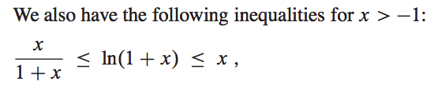
Logarithms

Slide 46
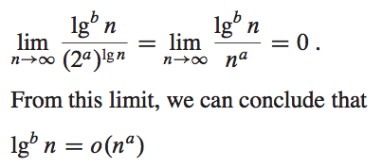
Logarithms

Slide 47
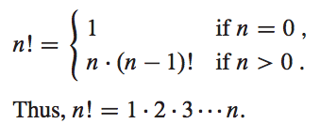



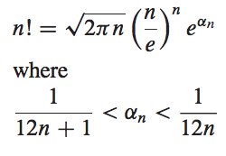
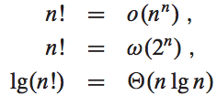

Factorials

Slide 48
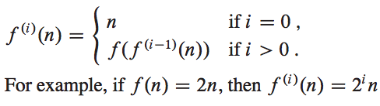
Functional Iteration

Slide 49

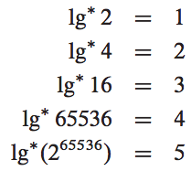
Iterated Logarithm

Slide 50
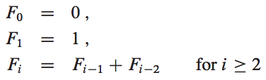

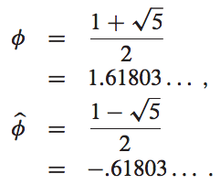




Fibonacci Numbers

Slide 51


Fibonacci Numbers

